Slide 1
Data Visualization Using Matplotlib

Slide 2
Explain to Matplotlib
Discuss features of Matplotlib
Describe Data Analysis using Matplotlib
Discuss Matplotlib basic Operations
Explain Matplotlib installation process .
Discuss Plotting

Slide 3

MatplotLib

Slide 4
What is Matplotlib
Matplotlib is a Data Visualization module used in Python
To display analysis in Graphical form
Quickly Interpret the data using Data Visualization
Adjusting variables and their values to change the visual effect

Slide 5
What is Matplotlib
Data Visualization – representation of
Python library used to create 2D graphics
It contains pyplot module which makes plotting easier
Quickly Used to plot Bar Chart, Pie Chart, Histogram, Area Chart, Scatter Chart etc
It is built on top of NumPy, SciPy and Matplotlib

Slide 6
Data Analysis
Scenario
Process of analyzing large set of data
Want to know how many Employees joined Accenture
Percentage of Employees either increased or decreased in 2017-2018 in BDC location
Document the outcome which location the values are constant, which location value is greater which location less Employees joined
Transform the dataset by adding or removing Data Set
Visualize the Data
This process will iterate for every analysis

Slide 7
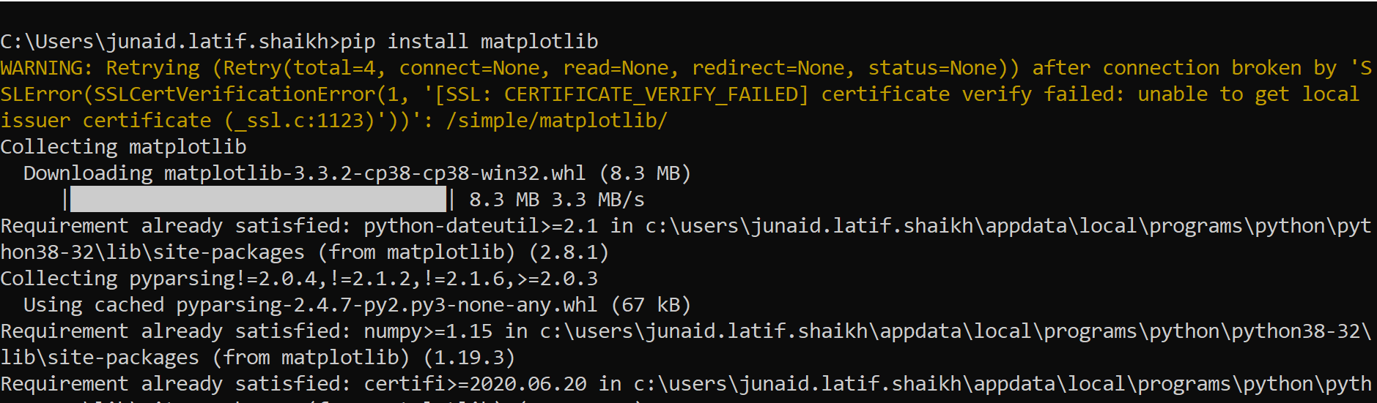
Installing Matplotlib
Installing Matplotlib

Slide 8
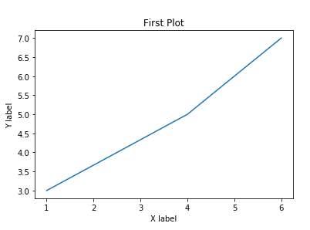
Demo Graph
import matplotlib.pyplot as mt
mt.plot([1,4,6],[3,5,7])
mt.title("First Plot")
mt.xlabel("X label")
mt.ylabel("Y label")

Slide 9
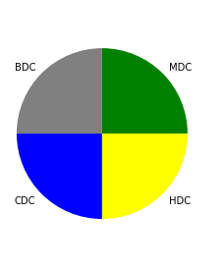
Plotting Pie chart
import matplotlib.pyplot as mt
labels=["MDC","BDC","CDC","HDC"]
size=[25,25,25,25]
color=["Green","grey","Blue","yellow"]
mt.pie(size,labels=labels,colors=color)

Slide 10
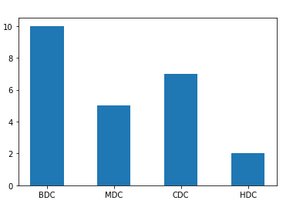
Plotting Bar diagram
import matplotlib.pyplot as mt
x=["BDC","MDC","CDC","HDC"]
y=[10,5,7,2]
mt.bar(x,height=y,width=0.5)

Slide 11
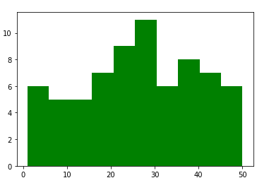
Plotting Histogram
import matplotlib.pyplot as plt
x = [1,1,2,3,3,5,7,8,9,10,
10,11,11,13,13,15,16,17,18,18,
18,19,20,21,21,23,24,24,25,25,
25,25,26,26,26,27,27,27,27,27,
29,30,30,31,33,34,34,34,35,36,
36,37,37,38,38,39,40,41,41,42,
43,44,45,45,46,47,48,48,49,50
]
plt.hist(x,color='green')

Slide 12
Matplotlib mcq questions
Question: What is Matplotlib primarily used for in Python?
A) Web Development
B) Data Visualization
C) Machine Learning
D) Data Analysis
Notes:
Answer: B) Data Visualization

Slide 13
Matplotlib mcq questions
Question: How do you import the Matplotlib library in Python?
A) import matplotlib.pyplot as plt
B) import matplotlib
C) import plt
D) import matplotlib.py
Notes:
Answer: A) import matplotlib.pyplot as plt

Slide 14
Matplotlib mcq questions
Question: Which function is used to create a line plot in Matplotlib?
A) plt.plot()
B) plt.line()
C) plt.graph()
D) plt.show()
Notes:
Answer: A) plt.plot()

Slide 15
Matplotlib mcq questions
Question: How do you display a plot in Matplotlib?
A) plt.show()
B) plt.display()
C) plt.render()
D) plt.exhibit()
Notes:
Answer: A) plt.show()

Slide 16
Matplotlib mcq questions
Question: Which function is used to create a scatter plot in Matplotlib?
A) plt.scatter()
B) plt.plot()
C) plt.points()
D) plt.bubble()
Notes:
Answer: A) plt.scatter()

Slide 17
Matplotlib mcq questions
Question: How do you add a title to a plot in Matplotlib?
A) plt.title('Title')
B) plt.set_title('Title')
C) plt.add_title('Title')
D) plt.name('Title')
Notes:
Answer: A) plt.title('Title')

Slide 18
Matplotlib mcq questions
Question: Which function is used to create a bar chart in Matplotlib?
A) plt.bar()
B) plt.bar_chart()
C) plt.bars()
D) plt.chart()
Notes:
Answer: A) plt.bar()

Slide 19
Matplotlib mcq questions
Question: How do you label the x-axis in a Matplotlib plot?
A) plt.xlabel('X-axis Label')
B) plt.xaxis('X-axis Label')
C) plt.label_x('X-axis Label')
D) plt.set_xlabel('X-axis Label')
Notes:
Answer: A) plt.xlabel('X-axis Label')

Slide 20
Matplotlib mcq questions
Question: Which function is used to create a histogram in Matplotlib?
A) plt.hist()
B) plt.histogram()
C) plt.bins()
D) plt.frequency()
Notes:
Answer: A) plt.hist()

Slide 21
Matplotlib mcq questions
Question: How do you save a plot as an image file in Matplotlib?
A) plt.savefig('filename.png')
B) plt.save('filename.png')
C) plt.export('filename.png')
D) plt.store('filename.png')
Notes:
Answer: A) plt.savefig('filename.png')

Slide 22
Explain to Matplotlib
Discuss features of Matplotlib
Describe Data Analysis using Matplotlib
Discuss Matplotlib basic Operations
Explain Matplotlib installation process .
Discuss Plotting

Slide 23
Thank You

